Slide 1
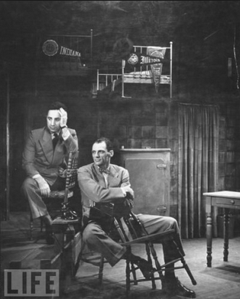
Elia Kazan and Arthur Miller on the set of Death of a Salesman

Slide 2
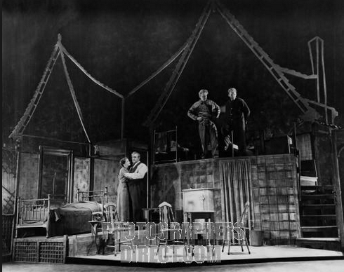
Mieliziner’s set design with its “drab realistic interiors to light, delicate frameworks …”

Slide 3
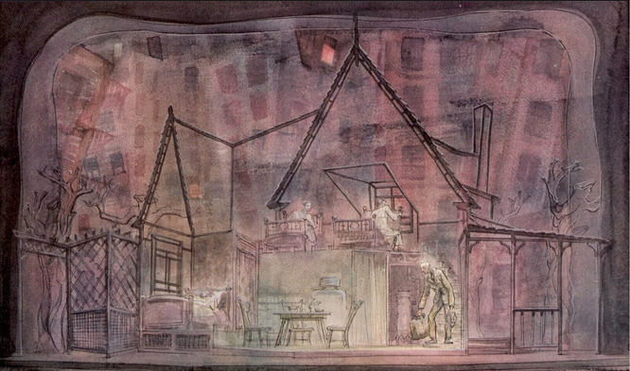
Mielziner’s design for the scrim showing surrounding apartments

Slide 4
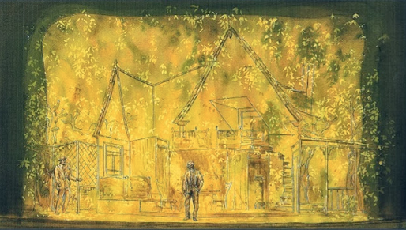
Mielziner’s design for the leafy scrim evoking Willy’s vibrant “daydreams”

Slide 5
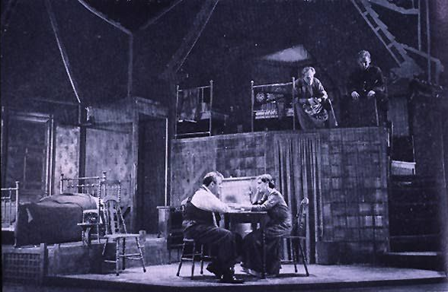
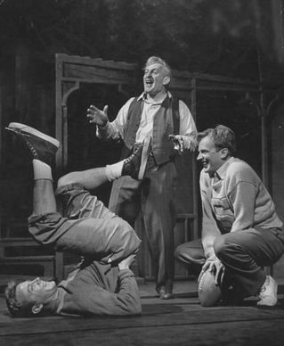
The challenge of getting Hap and Biff
from the upper bedroom in their pajamas
onto the Forestage in their school clothes

Slide 6
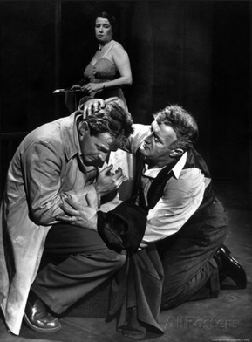
Willy (Cobb) embraces Biff (Kennedy)

Slide 7
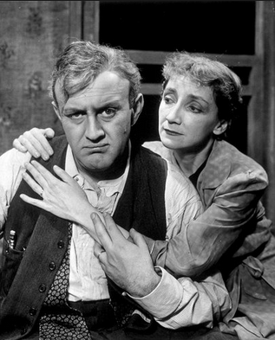
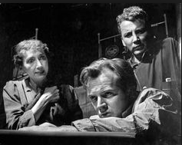
Linda (Dunnock) left:
embraces Willy (Cobb)
Above: scolds her sons

Slide 8
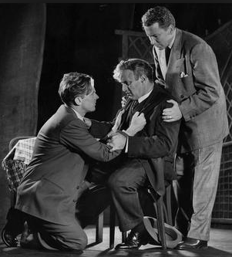
Biff tells his father the truth (as he sees it) as Hap stands by (Mitchell)

Slide 9
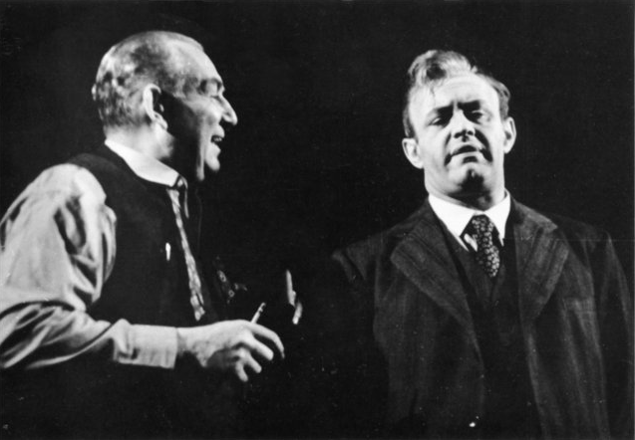
In charge, Ben (Chalmers) tells Willy about his success.

Slide 10
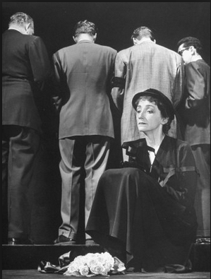
The requiem scene

Slide 11
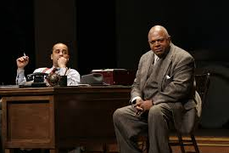
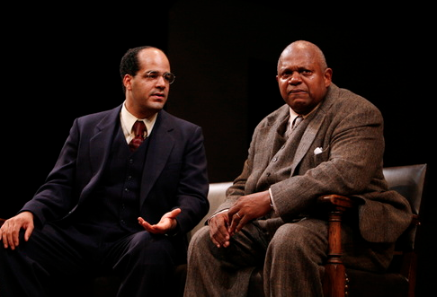
Death of a Salesman
at Yale Repertory Theatre,
New Haven, 2009

Slide 12
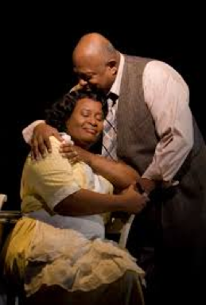
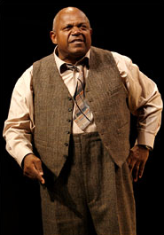
Charles S. Dutton as Willy Loman, Kimberly Scott as Linda Loman

Slide 13
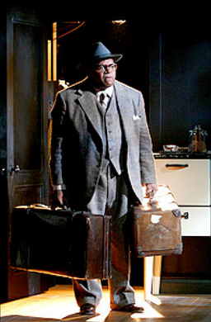
Willy with his suitcases

Slide 14
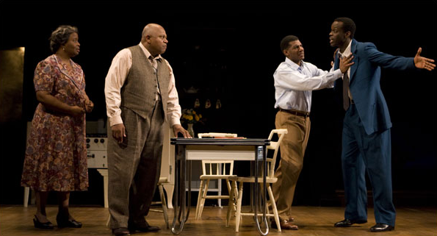
Linda (Scott), Willy (Dutton), Hap (Jones) and Biff (Essandoh)

Slide 15
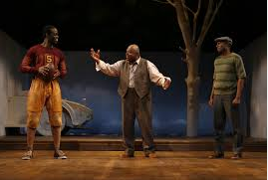
Behind are a white tree and car against a blue sky

Slide 16
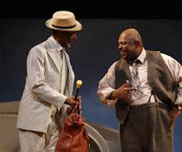
Ben (Thomas Jefferson Byrd ) chats to Willy

Slide 17
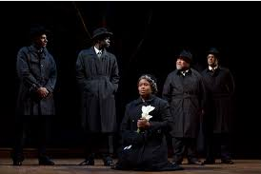
Requiem Scene

